Slide 1

HTTP Protocol for ESP32 developers
Mair Swartz

Slide 2

About me
Founder of http://learnesp32.com
Founder of http://lvgl.academy
20+ years development experience
Document Management systems
CMS
Web development
Microcontrollers
10+ years electronics experience
Mentor and trainer to thousands.

Slide 3
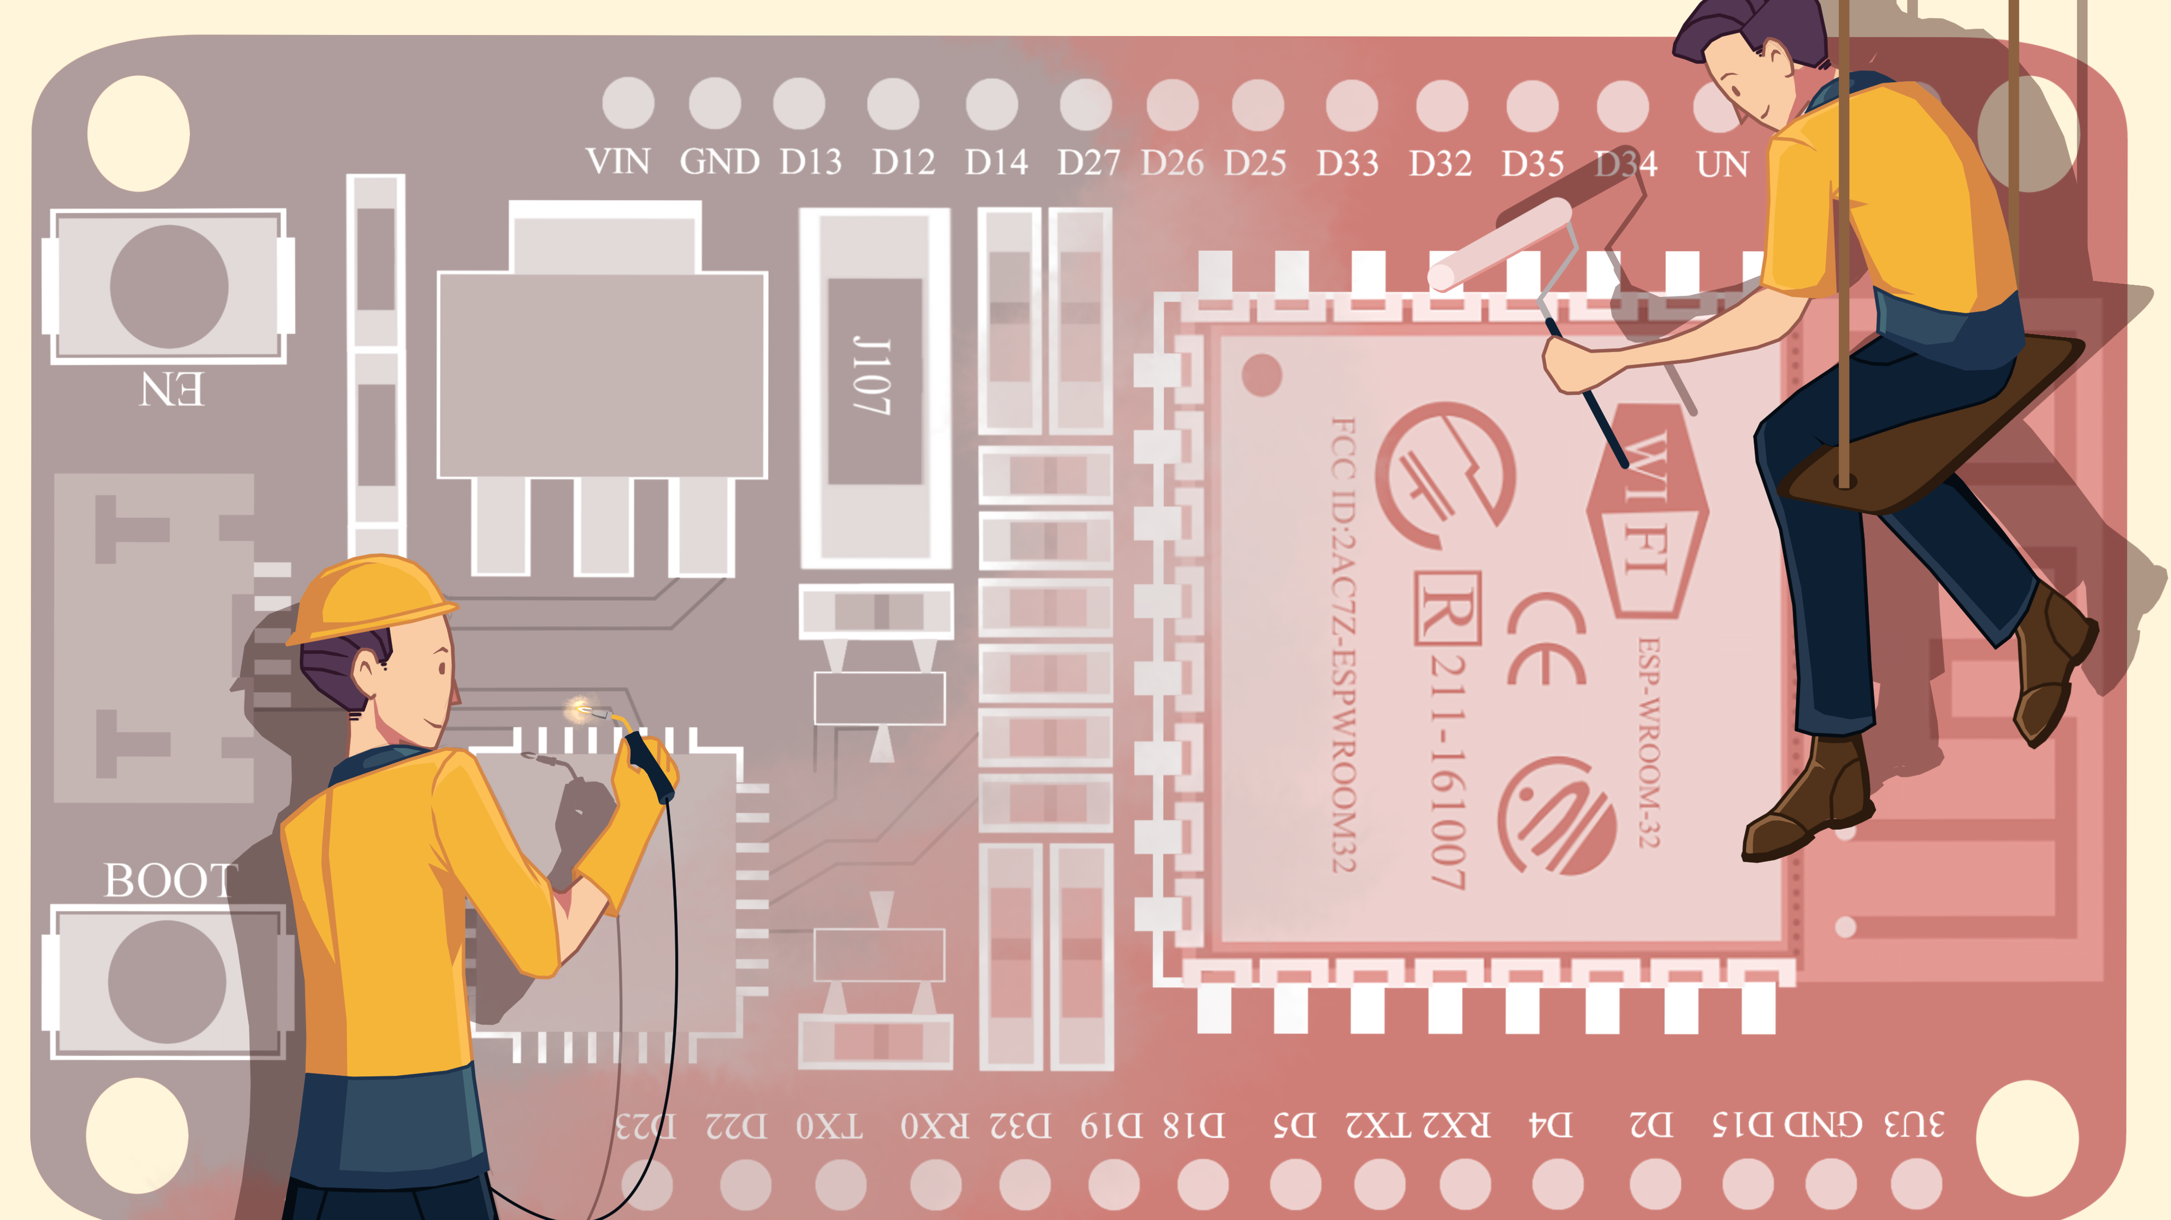
LearnESP32.COM
A great way to learn the ESP32

Slide 4
Why and when to use http protocol

Slide 5
What’s in the box?
We will cover:
Fundamental concepts of http and https
The ESP32 as a server
The ESP32 as a client
Tools to help you
We won’t cover (but maybe next time, if you are interested…):
Creating a web application
Exposing the ESP32 outside your network

Slide 6
Closing the knowledge gap
Embedded Development
Comm Protocols
Electronic Engineering
Cloud Services
[HTTP Protocol lives here]

Slide 7
Use HTTP Protocol when…
HTTP Protocol is a good choice when:
Your ESP32 is acting as a web server (Hosting web pages on the ESP32)
You wish to retrieve information from web / cloud services (AWS, Azure, databases, timetables, social media, etc.)
Simplicity and infrastructure costs are important factors to your project
Integrating into existing systems with existing security,
Use alternatives to HTTP protocol when:
Data needs to go to multiple subscribers (use MQTT)
Validation of message delivery / Quality of Service (QOS) is key (use MQTT)
Real time frequent data updates (use web sockets or web sockets over MQTT)

Slide 8
http bASICS

Slide 9


HTTP PROTOCOL IN A NUTSHELL
Request
Response
Client
Server

Slide 10
What we have learned so far:
Fact | Importance
A client sends a request, and the server sends a response | ⭐⭐⭐⭐⭐

Slide 11
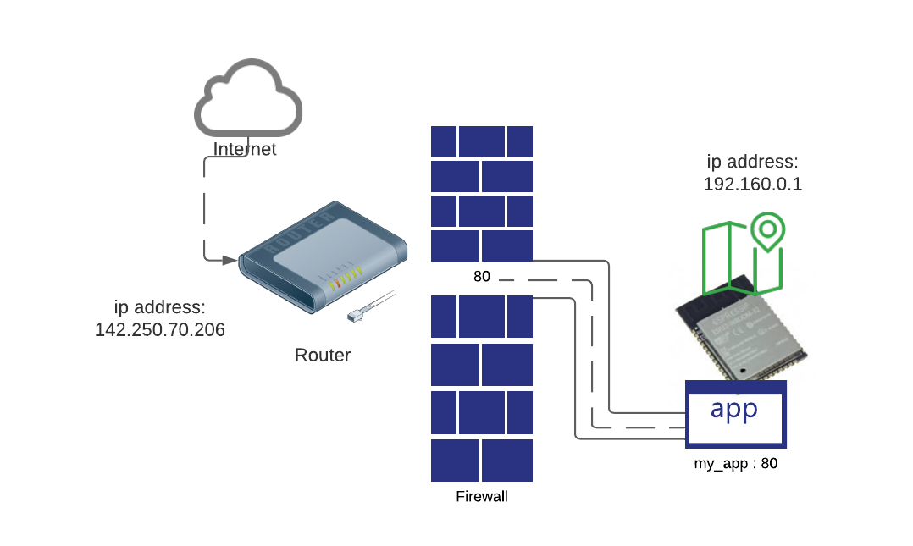

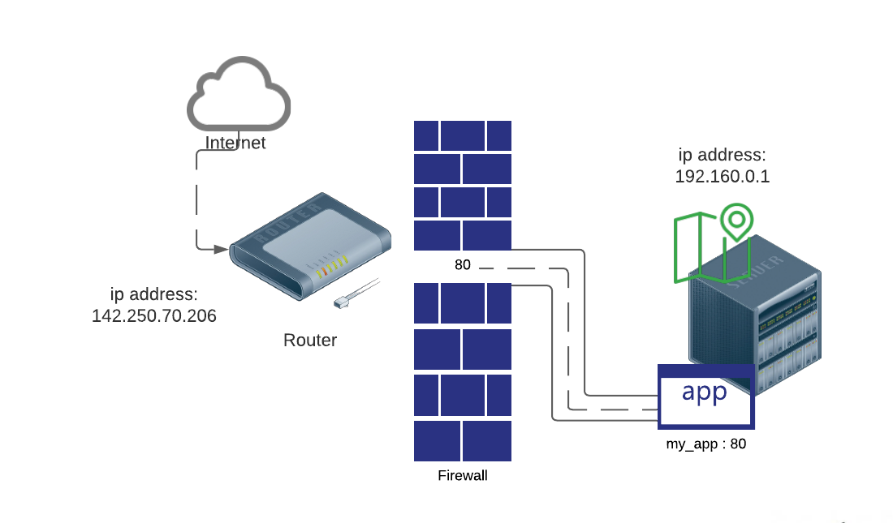
What's your Server address?
Servers have an IP address
applications listen for incoming data on a port
Internal / private network IPs are different to public IPs
Let’s observe the difference between a private and a public IP:

Slide 12
What we have learned so far:
Fact | Importance
A client sends a request, and the server sends a response | ⭐⭐⭐⭐⭐
Servers have an IP address | ⭐⭐⭐⭐
Applications listen on a port | ⭐⭐⭐

Slide 13
Domain Name Servers - DNS
IP addresses are inconvenient.
Domain name servers match a domain name like Google.com with an IP address
142.250.70.206
= Google.com

Slide 14
What we have learned so far:
Fact | Importance
A client sends a request, and the server sends a response | ⭐⭐⭐⭐⭐
Servers have an IP address | ⭐⭐⭐⭐
Applications listen on a port | ⭐⭐⭐
Domain names map to IP addresses | ⭐⭐⭐

Slide 15
What is a URL AND WHAT IS ITS ANATOMY?
A URL (Uniform Resource Locator) gives us a unique address on the web:
DOMAIN = (Ip address lookup)
http://gmail.google.com:80/inbox?somekey=somevalue
Protocol
Could also be…
https
ws
Mqtt
ftp
Etc.
Path (application specific)
(optional)
Query string
(Additional information
for the application)
(optional)
Sub domain
(optional)
Domain
Port

Slide 16
We don’t always need to specify a port
If the protocol is http, the default port is 80
If the protocol is https, the default port is 443

Slide 17
What we have learned so far:
Fact | Importance
A client sends a request, and the server sends a response | ⭐⭐⭐⭐⭐
Servers have an IP address | ⭐⭐⭐⭐
Applications listen on a port | ⭐⭐⭐
Domain names map to IP addresses | ⭐⭐⭐
A URL gives us a unique web address for an application or part thereof | ⭐⭐⭐⭐

Slide 18
A HTTP METHOD / VERB describes what the client request wants to do:
GET
The GET method requests a representation of the specified resource. Requests using GET should only retrieve data.
HEAD
The HEAD method asks for a response identical to that of a GET request, but without the response body.
POST
The POST method is used to submit an entity to the specified resource, often causing a change in state or side effects on the server.
PUT
The PUT method replaces all current representations of the target resource with the request payload.
DELETE
The DELETE method deletes the specified resource.
CONNECT
The CONNECT method establishes a tunnel to the server identified by the target resource.
OPTIONS
The OPTIONS method is used to describe the communication options for the target resource.
TRACE
The TRACE method performs a message loop-back test along the path to the target resource.
PATCH
The PATCH method is used to apply partial modifications to a resource.

Slide 19
More on Methods:
All web requests have a method that describes what it intends to do
The most common method is GET
If you don’t specify a method in your web request, the default is GET
A client can only receive information with a GET. If a client wants to give data to a server it must use a POST, PUT or PATCH
Most applications can get by using GET and POST

Slide 20
What we have learned so far:
Fact | Importance
A client sends a request, and the server sends a response | ⭐⭐⭐⭐⭐
Servers have an IP address | ⭐⭐⭐⭐
Applications listen on a port | ⭐⭐⭐
Domain names map to IP addresses | ⭐⭐⭐
A URL gives us a unique web address for an application or part thereof | ⭐⭐⭐⭐
All web requests have a method that describes what it intends to do | ⭐⭐⭐

Slide 21
A Simple Client Don’t stress – we’ll walk through it. This gets the current time in London:
elixir simple.exs
esp_http_client_config_t clientConfig = {
.url = "http://worldtimeapi.org/api/timezone/Europe/London/",
};
esp_http_client_handle_t client = esp_http_client_init(&clientConfig);
esp_err_t err = esp_http_client_perform(client);
if (err == ESP_OK)
{
int length = esp_http_client_get_content_length(client);
char *buffer = malloc(length + 1);
memset(buffer, 0, length + 1);
esp_http_client_read(client, buffer, length);
printf("%s\n", buffer);
}
Question:
What’s the..
Domain
Path
Port
Method
NB: The above code only works with small payloads. We will have a look at bigger payloads later.

Slide 22
Simple server
static esp_err_t on_url_hit(httpd_req_t *req){
char *message = "hello world!";
httpd_resp_send(req, message, strlen(message));
return ESP_OK;
}
void simple_server(void) {
httpd_handle_t server = NULL;
httpd_config_t config = HTTPD_DEFAULT_CONFIG();
ESP_ERROR_CHECK(httpd_start(&server, &config));
httpd_uri_t first_end_point_config = {
.uri = "/",
.method = HTTP_GET,
.handler = on_url_hit};
httpd_register_uri_handler(server, &first_end_point_config);
}

Slide 23
http headers:
http headers are key value pairs that give extra meaning to a web request or web response
You can add your own headers for any information you would like to transmit.
There are many standard headers. Here are some examples:
Content-Length
The size of the resource, in decimal number of bytes.
Content-Type
Indicates the media type of the resource.
Content-Encoding
Used to specify the compression algorithm.
Cookie
Contains stored HTTP cookies previously sent by the server with the Set-Cookie header.

Slide 24
Headers important information
Content-length is usually added by our http framework and we usually do not need to set it directly
Authorization caries information about the security of the client
Content-type tells the request or response what is being transmitted
Sometimes services protect themselves with an API key that goes in the header
Let’s see some examples of headers: (inline demo in the browser)

Slide 25
Common Content-Types
extension | Kind of document | Content-Type / MIME Type
.css | Cascading Style Sheets (CSS) | text/css
.csv | Comma-separated values (CSV) | text/csv
.gif | Graphics Interchange Format (GIF) | image/gif
.htm .html | HyperText Markup Language (HTML) | text/html
.jpeg .jpg | JavaScript | text/javascript
.json | JSON format | application/json
 | Binary | application/octet-stream
 | text | text/plain

Slide 26
What we have learned so far:
Fact | Importance
A client sends a request, and the server sends a response | ⭐⭐⭐⭐⭐
Servers have an IP address | ⭐⭐⭐⭐
Applications listen on a port | ⭐⭐⭐
Domain names map to IP addresses | ⭐⭐⭐
A URL gives us a unique web address for an application or part thereof | ⭐⭐⭐⭐
All web requests have a method that describes what it intends to do | ⭐⭐⭐
Header information gives additional data about the request | ⭐⭐⭐⭐
Content-Types indicate the type of data | ⭐⭐⭐

Slide 27
Response codes Response codes tell the client what happened to the request
Informational responses (100–199)
Successful responses (200–299)
Redirects (300–399)
Client errors (400–499)
Server errors (500–599)

Slide 28
Common Response Codes
Code | Meaning
200 | OK
301 | Moved Permanently (Redirect)
400 | Bad Request
401 | Unauthorised
403 | Forbidden
404 | Not Found
500 | Internal server error

Slide 29
What we have learned so far:
Fact | Relative Importance
A client sends a request, and the server sends a response | ⭐⭐⭐⭐⭐
Servers have an IP address | ⭐⭐⭐⭐
Applications listen on a port | ⭐⭐⭐
Domain names map to IP addresses | ⭐⭐
A URL gives us a unique web address for an application or part thereof | ⭐⭐⭐⭐
All web requests have a method that describes what it intends to do | ⭐⭐⭐
Header information gives additional data about the request | ⭐⭐⭐⭐
Content-Types indicate the type of data | ⭐⭐
A Response code tells the client how the server handled the request | ⭐⭐⭐⭐

Slide 30
HTTPS
Lets secure our connection

Slide 31




HTTPS PROTOCOL IN A NUTSHELL:
Encryption key negotiation
Cert.pem
Request
Client
Server
Response

Slide 32
HPPS PROTOCOL
The esp_http_client takes care of our SSL connection 😊😊😊
It can negotiate a key
It encrypts the request
It decrypts the response
So why do we have a cert_pem option in our client config?
esp_http_client_config_t clientConfig = {
.url = "https://my-ssl-ulr",
.cert_pem = "🤔🤔🤔"
};

Slide 33
HTTPS man in the middle / evil twin attack
Encryption key negotiation
Cert.pem
Request
Client
Server
Response

Slide 34
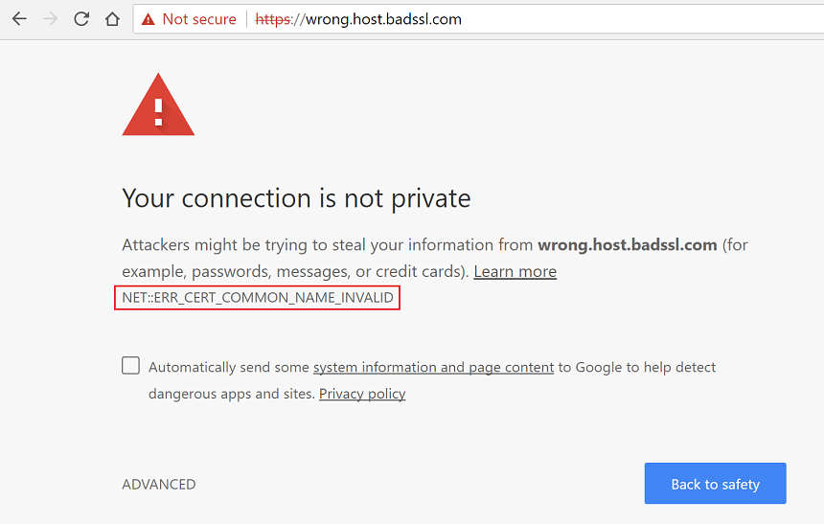
Validating the certificate:
Lucky for us, browsers take care of this by validating the certificate:
1. Certificates are built in chains
2. The certificate the client receives from a server will be part of a chain
3. The root of that chain is issued by a certificate authority
4. Your browser comes loaded with all the root certificates given out by certificate authorities.
5. If your browser does not recognise the certificate, You get a security warning
* Lets have a look at a certificate chain
* Lets have a look at the trusted certs

Slide 35
Validating a cert on the ESP32 client
We don’t store all root certificates on the ESP32
We just get the one we need and use it in the configuration
If the server gives us an invalid certificate, The ESP32 throws an error and will not connect

Slide 36
ESP HTTPS SERVER:
Component config → HTTP Server → Max HTTP Request Header Length (1024)
Component config → HTTPS Server → Enable ESP_HTTPS_SERVER
You can generate your own certificate using:
openssl.exe req -newkey rsa:2048 -nodes -keyout prvtkey.pem -x509 -days 3650 -out cacert.pem -subj "/CN=cert name"

Slide 37
Demo
https client
https server

Slide 38
What we have learned so far:
Fact | Relative Importance
A client sends a request, and the server sends a response | ⭐⭐⭐⭐⭐
Servers have an IP address | ⭐⭐⭐⭐
Applications listen on a port | ⭐⭐⭐
Domain names map to IP addresses | ⭐⭐
A URL gives us a unique web address for an application or part thereof | ⭐⭐⭐⭐
All web requests have a method that describes what it intends to do | ⭐⭐⭐
Header information gives additional data about the request | ⭐⭐⭐⭐
Content-Types indicate the type of data | ⭐⭐
A Response code tells the client how the server handled the request | ⭐⭐⭐⭐
For https, the server and client negotiate a key with a certificate | ⭐⭐⭐⭐
esp_http_client takes care of https connections | ⭐⭐⭐
An esp32 client can validate a server by passing the certificate to the config | ⭐⭐

Slide 39
Dealing With Data

Slide 40
Chunking data
New data!
New da
ta!
Our buffer
Our index
A new chunk has been passed to us.
It does not fit into our buffer so increase the memory size
Move the data into memory at the position of the index offset
Increase the index to the end of the data

Slide 41
Demo
Chunked client

Slide 42
JSON
JSON is the most widely used data structure on the internet
The IDF has CJSON built in
To send data to a server from an ESP32
Create a CJSON structure
Add data to it
Use the CJSON print function to create a string
Set the header “content-type” to “application/json”
Sent the payload as a string
Delete the CJSON structure
Free the string
cJSON *payload = cJSON_CreateObject();
cJSON_AddStringToObject(payload, "first_name", "John");
cJSON_AddStringToObject(payload, "sur_name", "Smith");
cJSON_AddNumberToObject(payload, "age", 21);
char *message = cJSON_Print(payload);
{
"first_name": "John",
"sur_name": "Smith",
"age": 21
}
Lets see a demo of a esp32 server that serves json

Slide 43
Demo
Json server

Slide 44
Parsing json
CJSON can turn a string into a CJSON structure using the CJSON parse function
Get a specific item in your json using cJSON_GetObjectItemCaseSensitive
Get the value by using the ->string or ->int etc.
cJSON *json = cJSON_Parse(buffer);
if (json)
{
cJSON *received_message = cJSON_GetObjectItemCaseSensitive(json, "message");
if (received_message)
{
printf("your message: %s", received_message->string);
…

Slide 45
Tools for http

Slide 46
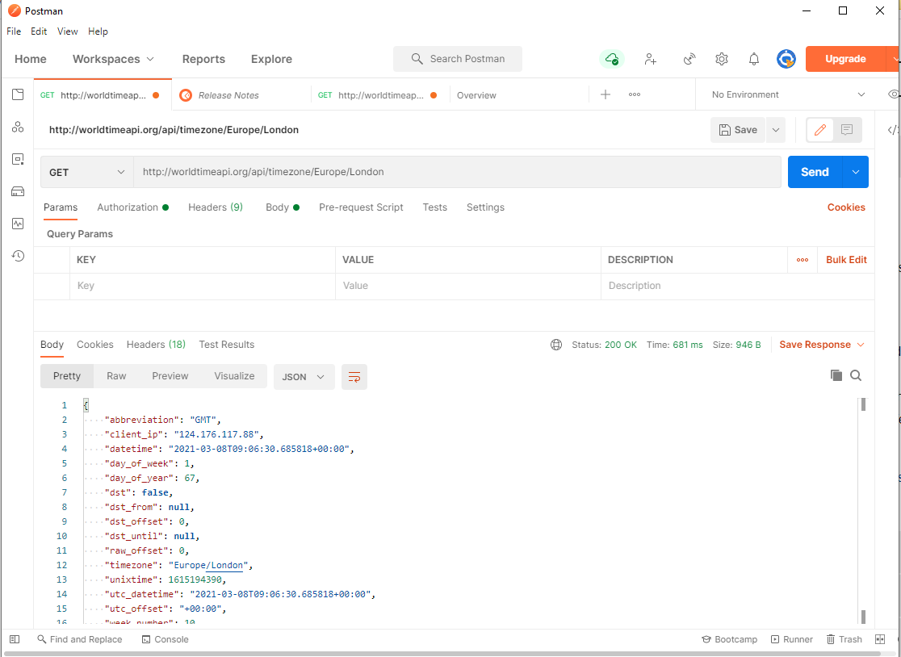
Postman
Very good acting as a client
Can send any method
Displays json well
Easy to set headers
Fairly simple to use
Can be used for free

Slide 47
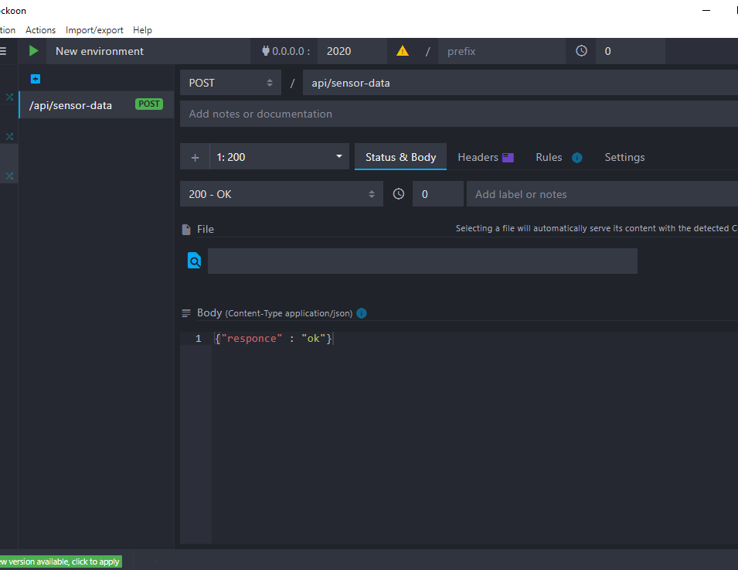
Mockoon
Excellent as a server
Listens on any port for any path
Listens for most verbs
Easy to use but also has interesting advanced features if needed

Slide 48
Demo Time
Postman and mockoon together
ESP32 Json server with post using postman
Esp32 Json client using mockoon

Slide 49

Thank You
Assignment…
Sign up with https://openweathermap.org/api
Get an API key
Create an esp32 server. When a URL is hit, the esp32 acts as a client to fetch the data from the weather API. The response is then given on the servers response

Slide 50
Questions?

